Slide 1


<Saleh Binsuwaylih>
<2023/6/12>

Slide 2

Outline
Executive Summary
Introduction
Methodology
Results
Conclusion
Appendix

Slide 3
Executive Summary
Metholedgy
Collect using API and web scraping
Data Wrangling
EDA with Data Visualization
EDA with SQL
Build a Dashboard with Plotly Dash
Predictive Analysis (Classification)
Result
Utilizing multiple models, we trained the data and compared accuracy on both testing and training sets. This approach offers a concise yet thorough assessment of model performance and generalization capabilities.

Slide 4
Introduction
This machine learning project is designed to predict the success of the first stage landing of a rocket. The primary objectives include identifying relationships between attributes and determining the most suitable model to fit the data, aiming for the highest accuracy.
SpaceX has disrupted the space industry by offering Falcon 9 launches at just 62 million dollars, significantly undercutting competitors. Their groundbreaking idea of reusing the first stage through precise re-landing drives these cost savings. As a data scientist for a startup rivaling SpaceX, our project aims to predict first-stage landing outcomes using machine learning, crucial for bidding competitively. Challenges include identifying key landing factors, understanding variable relationships, and determining optimal conditions for success. • The objective for Space Y, a new player, is to assess its competitiveness against SpaceX. Our focus is on predicting successful first-stage landings to estimate total launch costs effectively. Additionally, the analysis aims to identify optimal launch locations, providing strategic insights for Space Y's market positioning and competition with SpaceX.

Slide 5

Section 1

Slide 6
Methodology
Executive Summary
Data collection methodology:
The data was collected from two source Api and Web Scraping. by the API from SpaceX Json, creating data frame from the response of the API. And the Web Scraping using beautifull soup.
Api ( https://api.spacexdata.com/v4/rockets/ )
Web Scraping ( https://en.wikipedia.org/wiki/List_of_Falcon/_9/_and_Falcon_Heavy_launches )
Perform data wrangling
The data procced using pandas and numpy library
Perform exploratory data analysis (EDA) using visualization and SQL
Perform interactive visual analytics using Folium and Plotly Dash
Perform predictive analysis using classification models
Train the data using Linear Logistic, KNN, SVM and decision tree to find the best model

Slide 7
Data Collection
The data was collected using the API as json and then parse in data frame it ,from SpaceX provider.
Fetch the core of the rocket , payload and launch Site then store it in lists and make it data frame
GetBoosterVersion() : taking data as parameter and fetch from API (name) using rocket column from data.
getLaunchSite(): taking data as parameter and fetch from API (longitude, latitude, name) using launchpad column from data.
getPayloadData(): taking data as parameter and fetch from API (mass_kg, orbit, name) using payloads column from data.

Slide 8
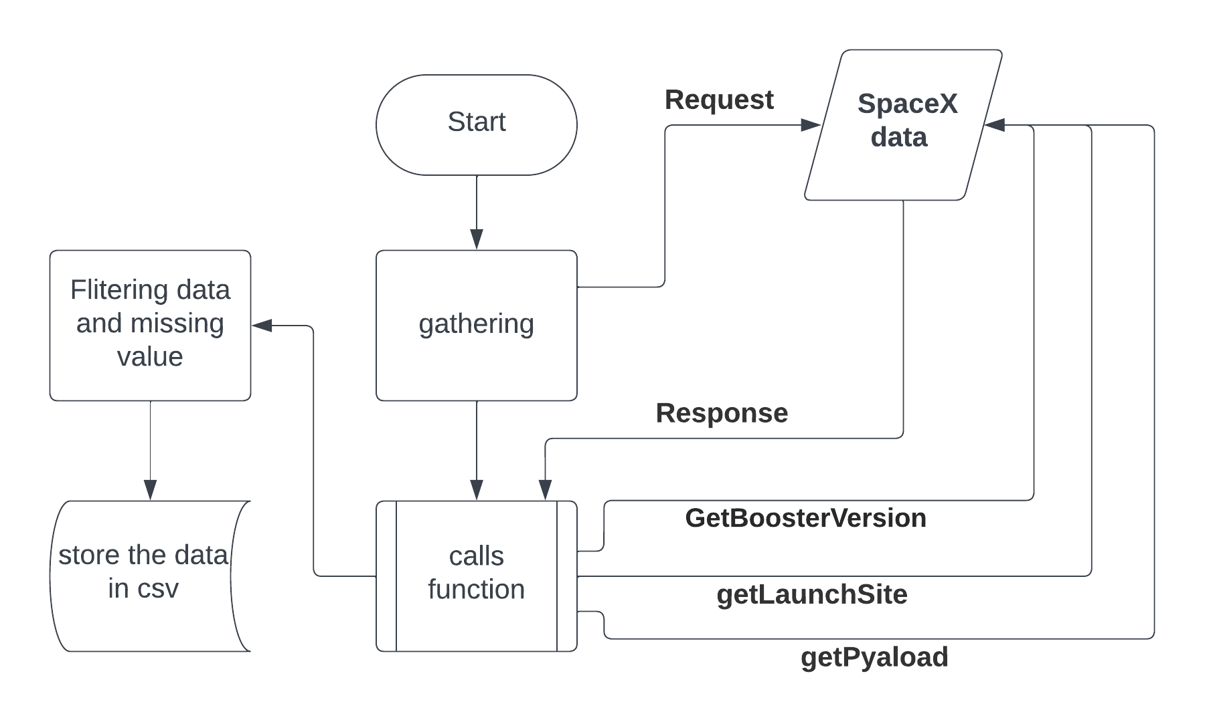
Data Collection – SpaceX API
Present your data collection with SpaceX REST calls using key phrases and flowcharts
Find more information in GitHub repository:
https://github.com/Sbinsuwaylih/SpaceX-Prediction-and-Analysis/blob/main/spacex-data-collection-api-Part-1.ipynb

Slide 9
Data Collection
The data was collected by the web scraping from Wikipedia and then parse in data frame it.
Request the data from the table in Wikipedia using Beautifullsoup()
Give the URL to the function and return the html. Find the table with find_all()
And get all the cloumns to the list then make it in data frame then filter the data and save it in csv file

Slide 10
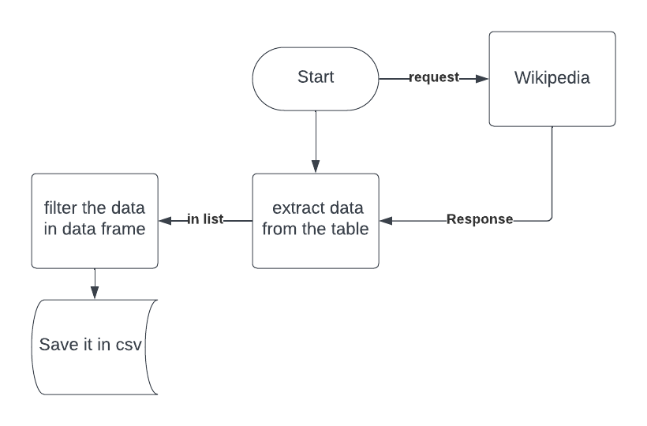
Data Collection - Scraping
Present your web scraping process using key phrases and flowcharts
Find more information in GitHub repository:
https://github.com/Sbinsuwaylih/SpaceX-Prediction-and-Analysis/blob/main/Webscraping.ipynb
Place your flowchart of web scraping here

Slide 11
Data Wrangling
The data was cleaned after removing the null values
Cheking from data types
Count the number of launch site find that :
CCSFS SLC has 40 site , 55, KSC LC 39A had 22 site and VAFB SLC 4E had 13 site
Calculate the number and occurence of mission outcome of the orbits
Crating class column which present if the land was successful assigned to 1, otherwise to 0 .
Note that the success rate is 0.66.
https://github.com/Sbinsuwaylih/SpaceX-Prediction-and-Analysis/blob/main/labs-jupyter-spacex-Data%20wrangling-Part_2.ipynb
Notes:
Add the GitHub URL of your completed EDA with data visualization notebook, as an external reference and peer-review purpose

Slide 12
EDA with Data Visualization
Use the scatter plot to discover if there any relation between the Payload Mass / LaunchSite / Orbit with FlightNumber.
Apply the the function catplot() from the seaburn library
plot to find relation between years and success rate.
Lastly, convert the data using get_dummy() then one hot encoding for machine learning.
Use the bar chart to check if there is relation between the success rate and orbit type
https://github.com/Sbinsuwaylih/SpaceX-Prediction-and-Analysis/blob/main/EDA-dataviz-Part_4.ipynb
Notes:
Add the GitHub URL of your completed EDA with data visualization notebook, as an external reference and peer-review purpose

Slide 13
EDA with SQL
List the total number of successful and failure mission outcomes
select Mission_Outcome, count(Mission_Outcome) as "Total of mission outcomes“ from 'SPACEXTABLE’ group by Mission_Outcome
List the records which will display the month names, failure landing_outcomes in drone ship ,booster versions, launch_site for the months in year 2015.
select substr(Date,6,2) as month, substr(Date,0,5) as year, Booster_Version, Launch_Site from 'SPACEXTABLE’ where Landing_Outcome = "Failure (drone ship)" and year = '2015'
Display the names of the unique launch sites in the space mission
select distinct Launch_Site from 'SPACEXTABLE'
Display the total payload mass carried by boosters launched by NASA (CRS)
select Customer,sum(PAYLOAD_MASS__KG_) from 'SPACEXTABLE’ where Customer like '%CRS%’
https://github.com/Sbinsuwaylih/SpaceX-Prediction-and-Analysis/blob/main/EDA-SQL-Part_3.ipynb
Notes:
Add the GitHub URL of your completed EDA with SQL notebook, as an external reference and peer-review purpose

Slide 14
Build an Interactive Map with Folium
Creating map using Floium library with folium marker get the Latitud ,Longitude from the dataframe and put in location parmmeter in the function do display all the site with successful lanch site
And show the distance between the coast and launch site
https://github.com/Sbinsuwaylih/SpaceX-Prediction-and-Analysis/blob/main/launch_site_location-Part_5.ipynb
Notes:
Add the GitHub URL of your completed interactive map with Folium map, as an external reference and peer-review purpose

Slide 15
Build a Dashboard with Plotly Dash
Use the pie chart and the scatter chart from plotly express to show the total success launches by the all sites.
By grouping the data with class column and lancuh site we show the total success rate
Also grouping the data with specific launch site to show the total of success rate in this site.
https://github.com/Sbinsuwaylih/SpaceX-Prediction-and-Analysis/blob/main/dashboard.ipynb
Notes:
Add the GitHub URL of your completed Plotly Dash lab, as an external reference and peer-review purpose

Slide 16
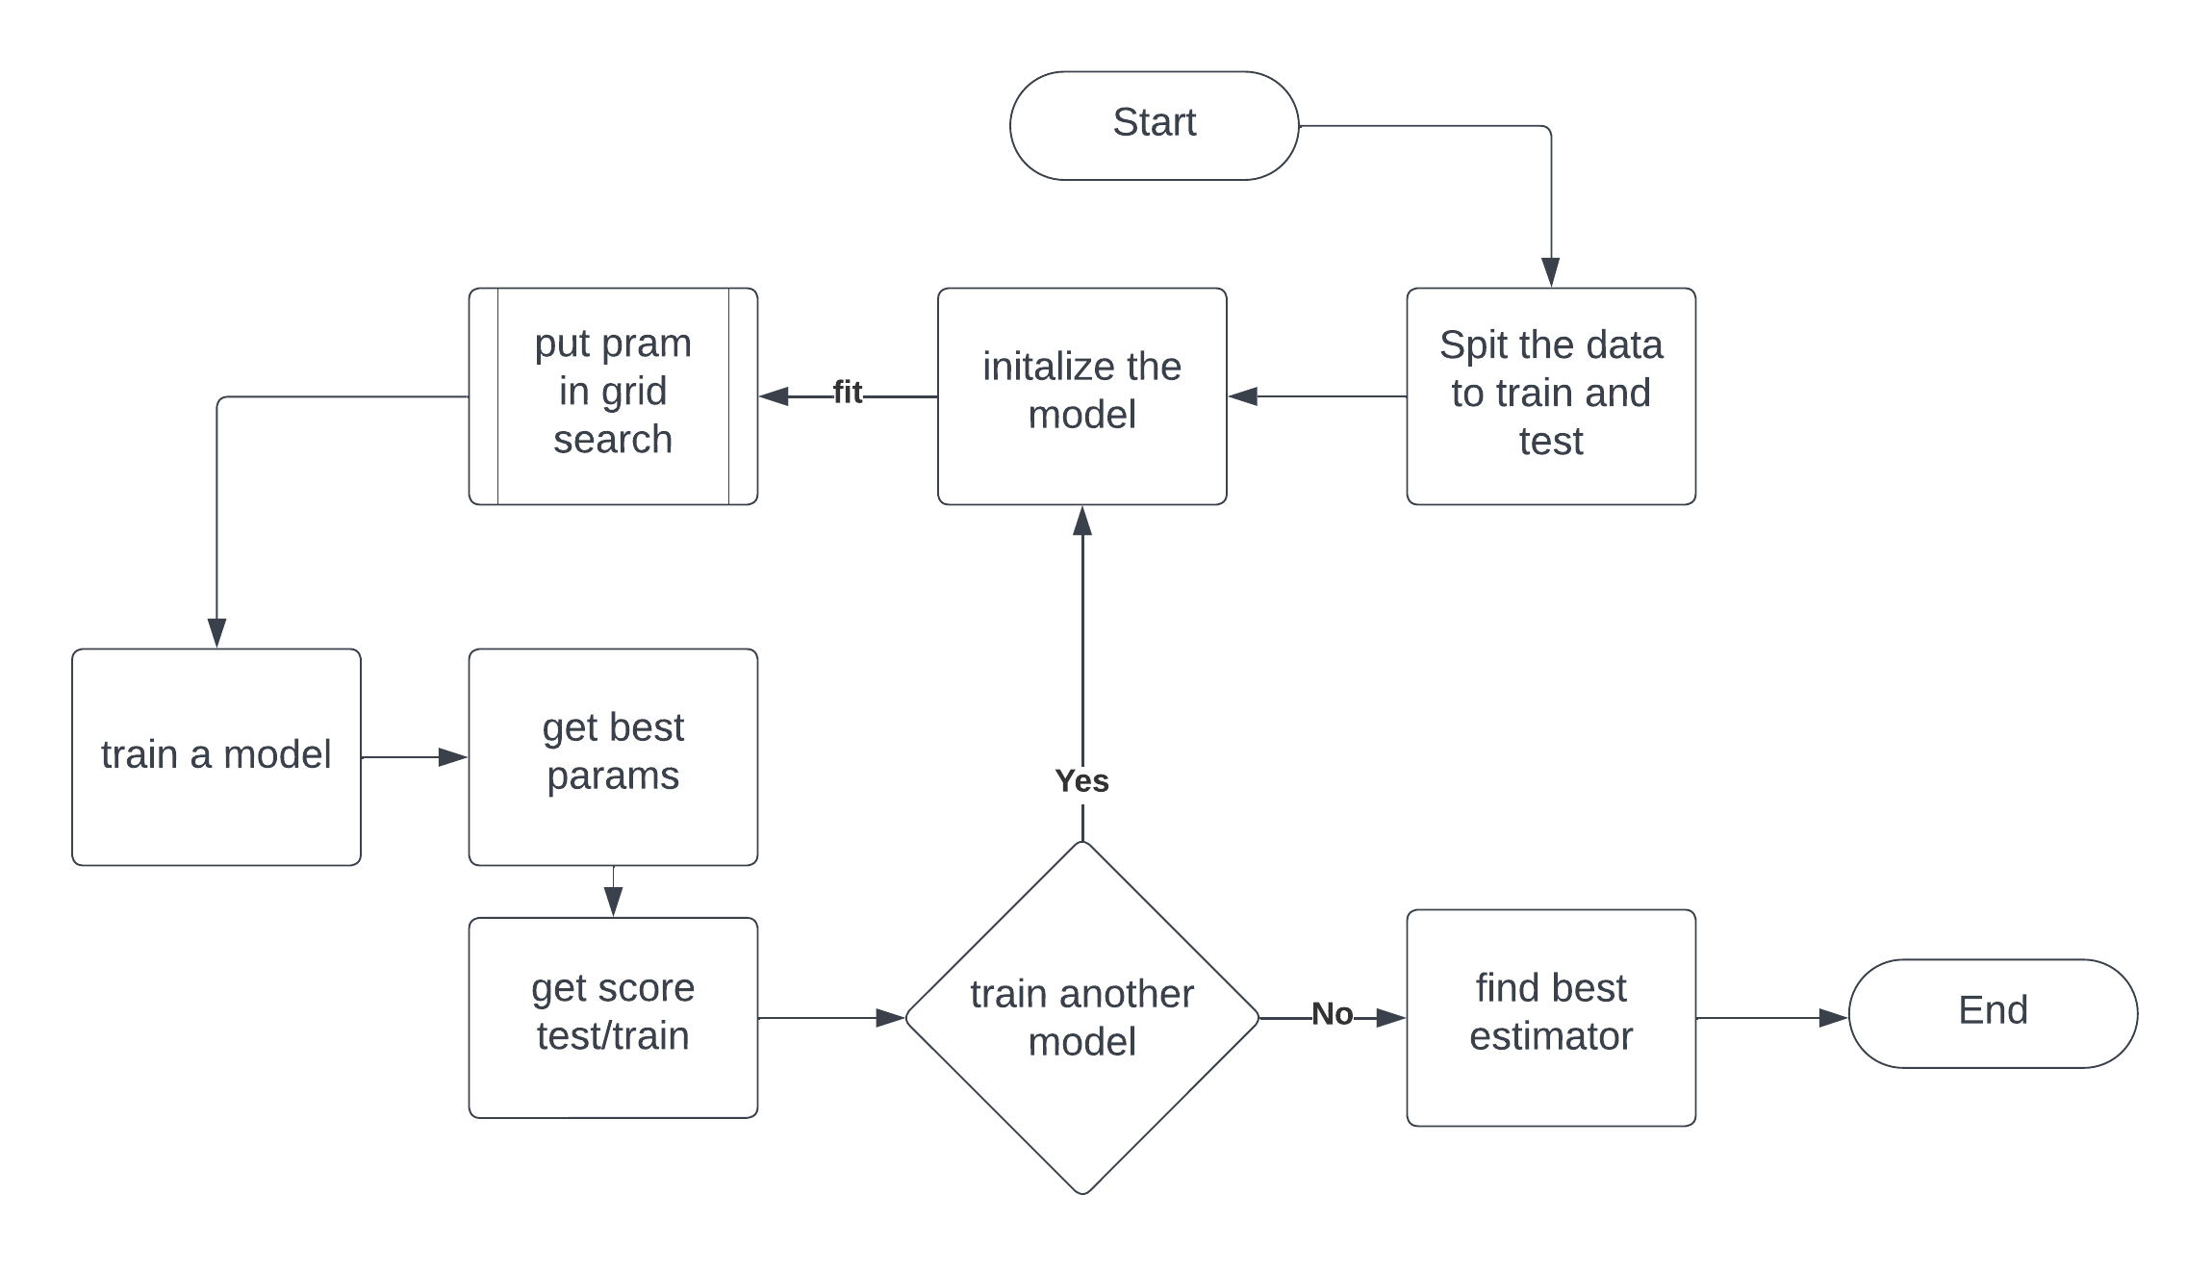
Predictive Analysis (Classification)
Using the sklearn library to use many machine learning model to find the best one to classification the data. for instance :
Linear logistic regression, SVM, KNN, Decision tree
Find the best parameter for each by using GridSearch.
https://github.com/Sbinsuwaylih/SpaceX-Prediction-and-Analysis/blob/main/SpaceX_Machine_Learning_Prediction_Part_6.ipynb
Notes:
Add the GitHub URL of your completed predictive analysis lab, as an external reference and peer-review purpose

Slide 17
Results
Exploratory data analysis results
Interactive analytics demo in screenshots
Predictive analysis results

Slide 18

Section 2

Slide 19
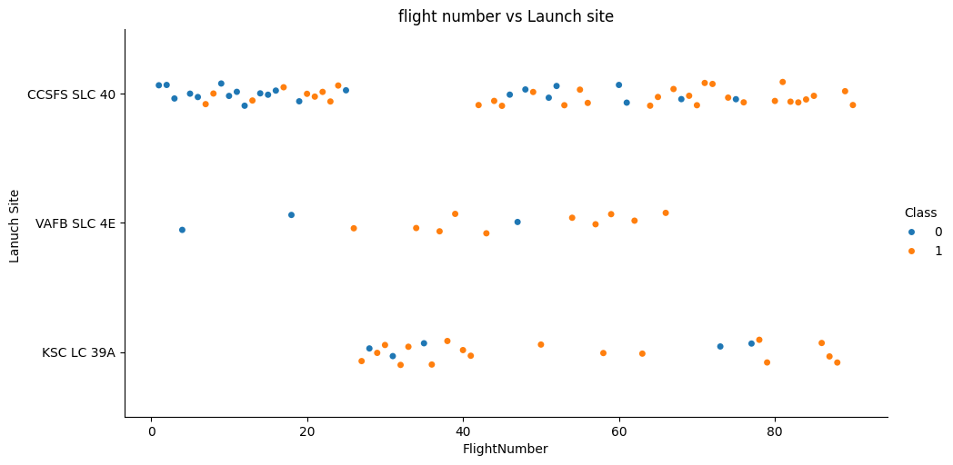
Flight Number vs. Launch Site
This diagram represent the scatter chart between the flight number and launch site
Observing that within the flight number increase the launch site also increase all launches site

Slide 20
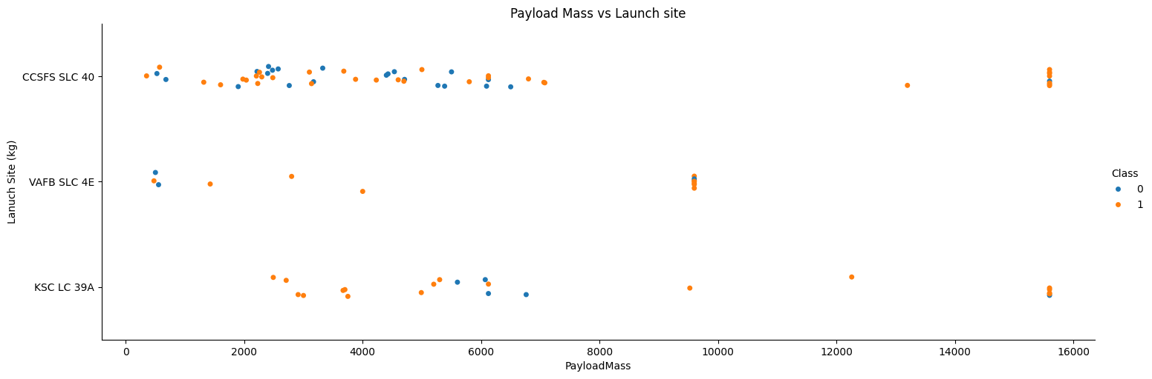
Payload vs. Launch Site
This diagram represent the scatter chart between the Payload mass (kg )and launch site
Observing that VAFB is not having paload mass more than 9600 unlike the others.

Slide 21
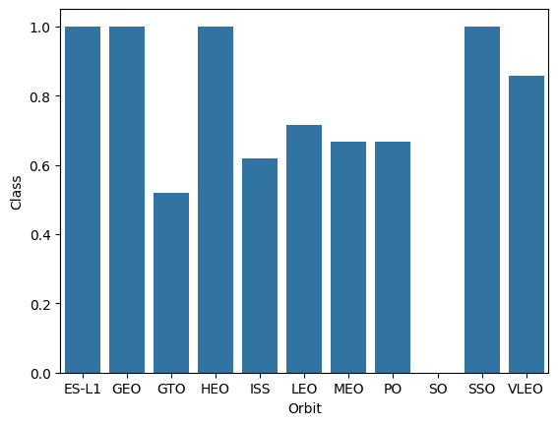
Success Rate vs. Orbit Type
This diagram represents the bar chart depicting the highest success rates for all orbits.
SO has the lowest success rate, while ES, GEO, HEO, and SSO have the highest rates

Slide 22
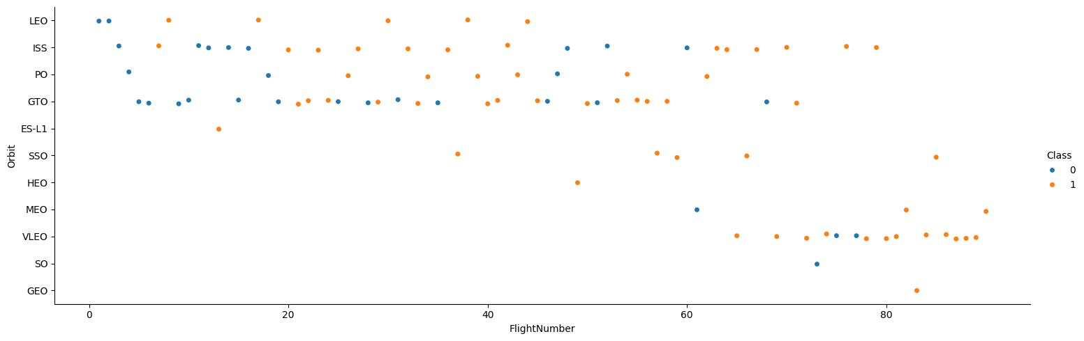
Flight Number vs. Orbit Type
This diagram represents the scatter chart depicting the relationship between the orbit type and flight number.
In LEO orbit, there is a relation, while GTO exhibits an explicit correlation.

Slide 23
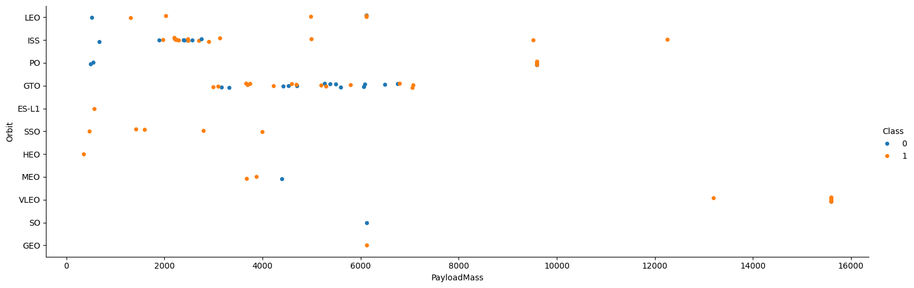
Payload vs. Orbit Type
This diagram represents the scatter chart depicting the relationship between the orbit type and Payload mass.
VLEO,ISS has the largest success rate

Slide 24
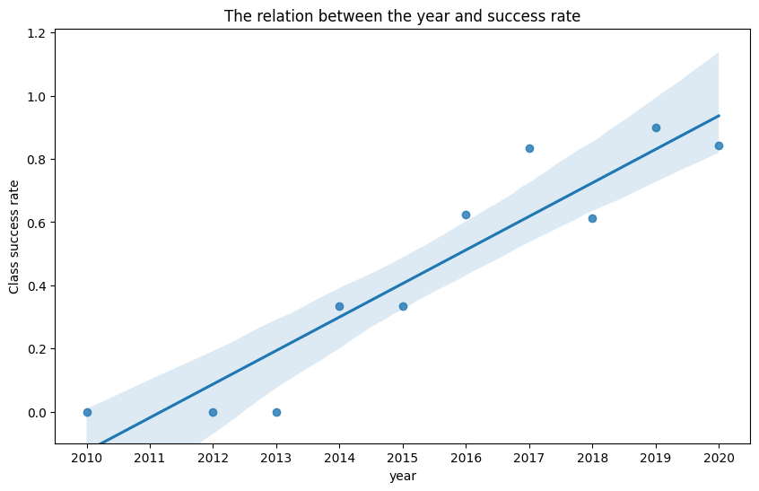
Launch Success Yearly Trend
This diagram represents the line chart depicting the relationship between the success rate with year.
The are positive correlation Starting from 2013 until 2020

Slide 25
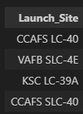
All Launch Site Names
This is list of all unique name in launch site from the SpaceX
CCAFS LC-40
VAFB SLC-4E
KSC LC-39A
CCAFS SLC-40

Slide 26
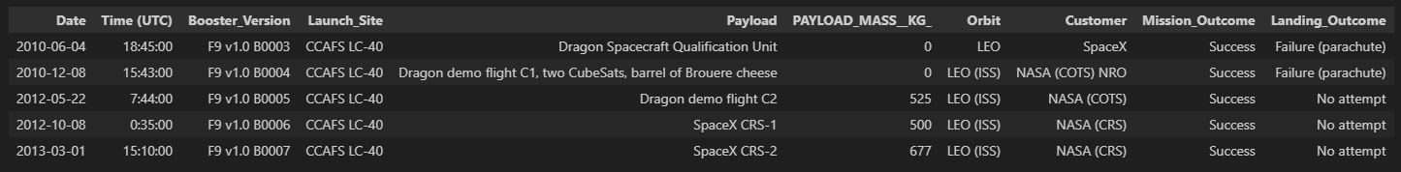
Launch Site Names Begin with 'CCA'
This is 5 records where launch sites begin with `CCA` from spaceX.
Observing that mission outcome success and landing outcome id failure or not attempt and the orbit is LEO

Slide 27
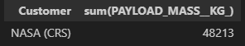
Total Payload Mass
Calculate the total payload carried by boosters from NASA
We can see the total is 48213 kg from NASA (CRS)

Slide 28
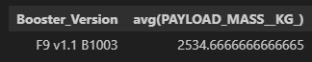
Average Payload Mass by F9 v1.1
Calculate the average payload mass carried by booster version F9 v1.1
The booster version F9 v1.1 B1003 the average for payload mass is 2534.67 kg.

Slide 29

First Successful Ground Landing Date
This query shows the dates of the first successful landing outcome on ground pad
Launch site in CCAF LC-40 with paload mass 2034 which is almost the average.

Slide 30
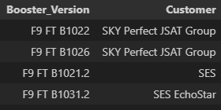
Successful Drone Ship Landing with Payload between 4000 and 6000
This query shows list of names of boosters which have successfully landed on drone ship and had payload mass greater than 4000 but less than 6000
Two of them are from customer SKY and two from SES

Slide 31
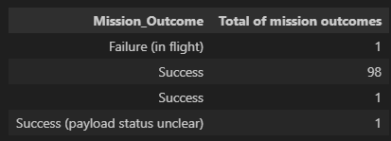
Total Number of Successful and Failure Mission Outcomes
The total number of successful and failure mission outcomes.
Only one Failure in flight while there are 100 success .

Slide 32
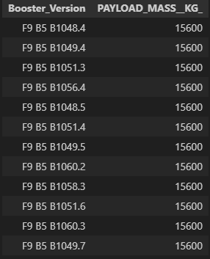
Boosters Carried Maximum Payload
List the names of the booster which have carried the maximum payload mass.
Maximum payload mass is 15600 kg from booster F9 B5

Slide 33
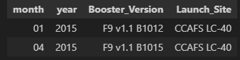
2015 Launch Records
List the failed landing_outcomes in drone ship, their booster versions, and launch site names for in year 2015
We can see here in 2015 landing outcome wass failed from the same launch site.

Slide 34
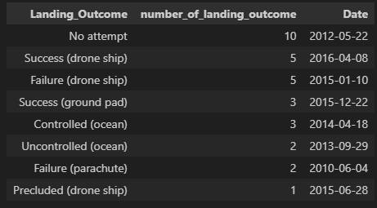
Rank Landing Outcomes Between 2010-06-04 and 2017-03-20
Rank the count of landing outcomes (such as Failure (drone ship) or Success (ground pad)) between the date 2010-06-04 and 2017-03-20, in descending order
In 2012 there are a lot of no attempt landing outcome

Slide 35

Section 3

Slide 36
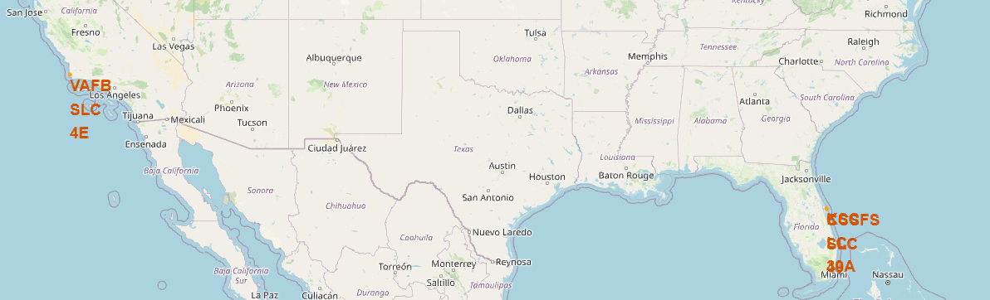
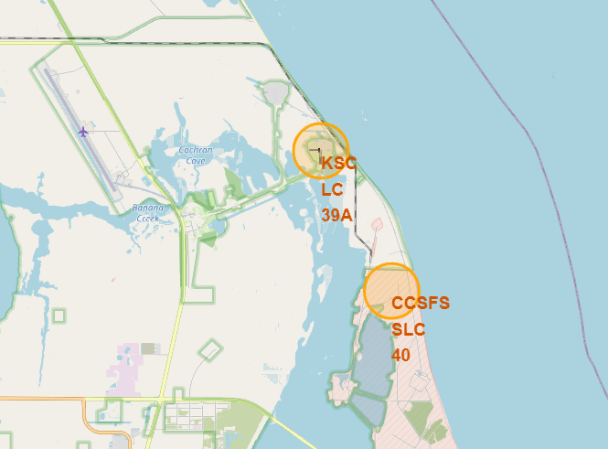
<Location of launch site in US>
VAFB is located to the west of Los Angeles. In Florida, there are KSC and CCSFS.
All launch sites are near the coast.

Slide 37
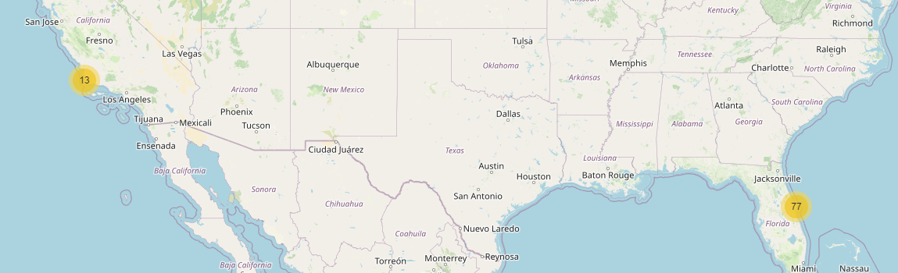
<Mark the launch site Location >
Here create maker for each location and label the circle with number of launches.

Slide 38
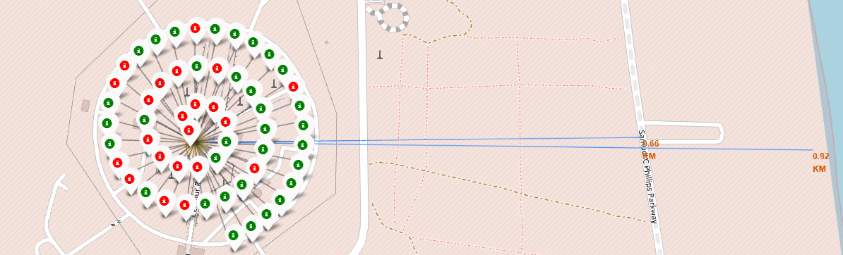
< CCSFS lancuh site and distance from road>
1.Launch site Complex 40 is far from the railway by 0.6 km, whereas the other launch sites are near the railways. 2. All launch sites are close to the highways.
3. All launch sites are far from cities for safety

Slide 39

Section 4

Slide 40
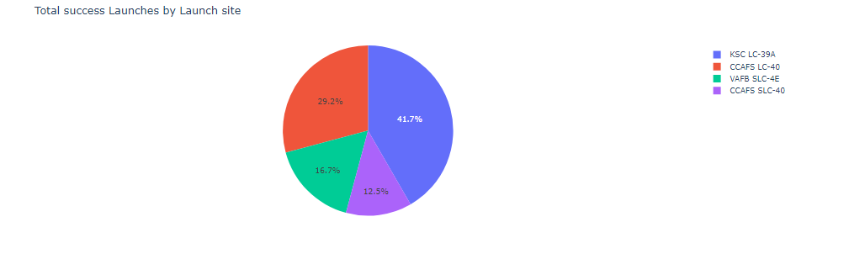
<Total launches>
KSC has the most success rate comparing with other launches with %41.7
CCAFS has the lowest success rate with %12.5

Slide 41
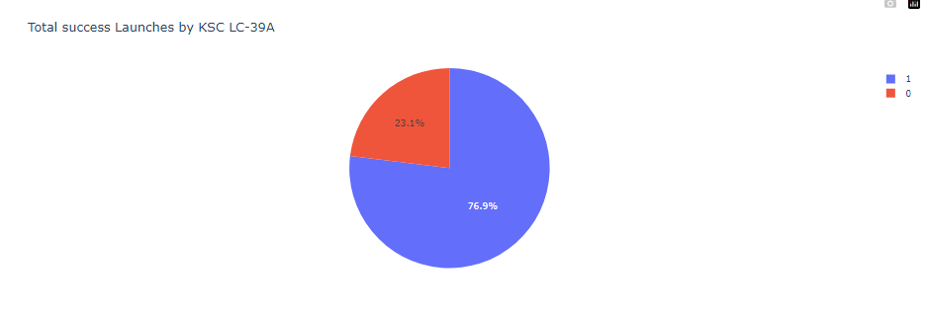
<Total suceess launch by KSC>
KSC has 76.9 success rate and 23.1 failure rate

Slide 42
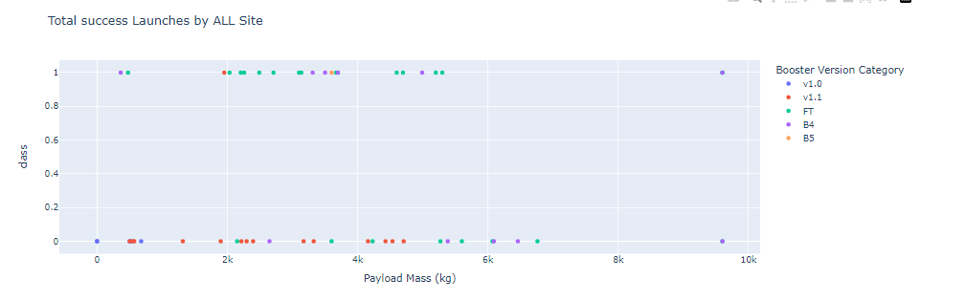
<Total success launches by all site >
1. The launch site with the highest successful launch rate is KSC LC-39A, and it has the largest successful launch payload capacity at 38,463.65 kg
2. VAFB SLC-4E has the highest successful launch rate in the payload range(s) with a capacity of 96,000 kg. Its booster version category is B4. On the other hand, the lowest payload capacity is at CCAFS SLC-40 with 362 kg.

Slide 43

Section 5

Slide 44
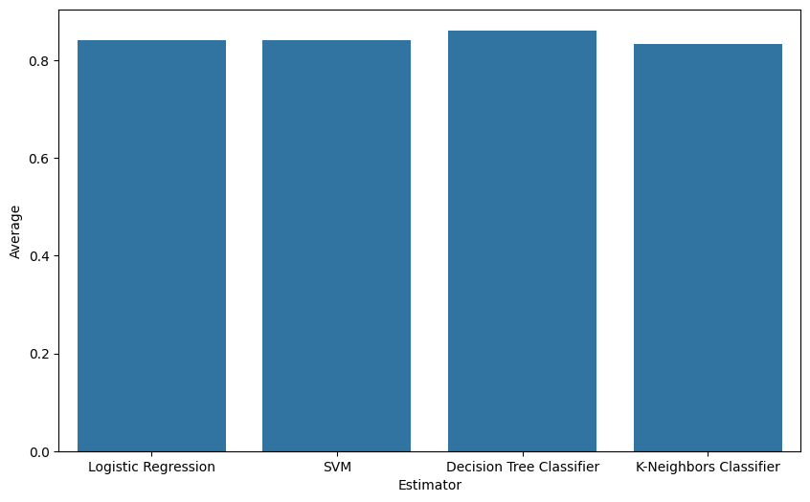
Classification Accuracy
The data trained using 4 machine learning models Logistic Regession, SVM, Decision Tree Classifier, KNN
Random state in splitting is 2
All model have accuracy around %80 but the highest one is Decision Tree Classifier with %86 accuracy.
This bar chart are built with the average of test and train accuracy.

Slide 45
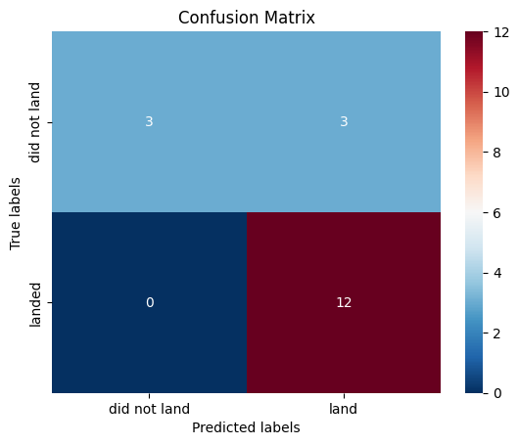
Confusion Matrix
No misclassifying in true positive while in
True negative and false negative there are 3 misclassifying

Slide 46
Conclusions
This project aims to predict whether the rocket's first stage will successfully land or not. The data was collected from the SpaceX API. The initial steps involved data cleaning and handling null values. Subsequently, a visualization of the columns with the target class was performed to identify any patterns in the data. The data was then processed to fit into machine learning models. Finally, various machine learning models were implemented to find the best one that provides the highest accuracy.
Use the Decision tree and find %86 accuracy.

Slide 47
Appendix
Include any relevant assets like Python code snippets, SQL queries, charts, Notebook outputs, or data sets that you may have created during this project

Slide 48


